Slide 1


jQuery
The JavaScript Library

Slide 2

Course objectives
jQuery
By following this course, you will be able to:
Enumerate the main advantages of using jQuery
Manipulate CSS properties
Design simple JavaScript animations
Do event programming
Manipulate content

Slide 3

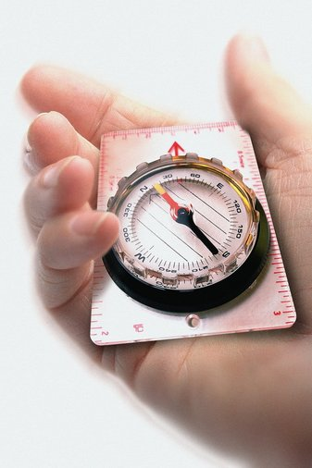
Course plan
jQuery
Discovery of jQuery
Selectors
CSS Manipulation
Event
Content Manipulation

Slide 4
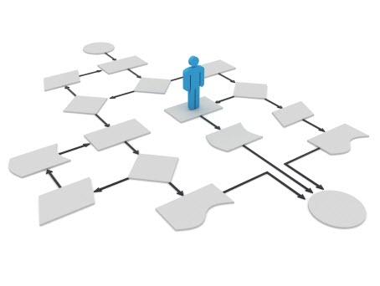
discovery
jQuery

Slide 5

Presentation
Discovery
Library designed to simplify the use of JavaScript
First release in 2006 by John Resig
Actual version: 1.7.x
The most popular JavaScript library !
Used by over 31% of the 10 000 most visited websites

Slide 6

Presentation
Discovery
Free and Open Source
Extendable easily!
Has many Plugins
Image sliders
Form validators
File upload tools
Etc…
Notes:
Examples:
http://nivo.dev7studios.com

Slide 7

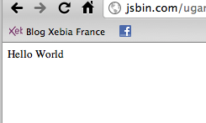
Hello world
Discovery
<html xmlns="http://www.w3.org/1999/xhtml" xml:lang="fr" >
<head>
<title>Hello World avec jQuery</title>
<meta http-equiv="Content-Type"
content="text/html; charset=iso-8859-1" />
<script type="text/javascript" src="jquery.js"></script>
</head>
<body>
Hi !
<script type="text/javascript">
$('body').html('Hello World');
</script>
</body>
</html>

Slide 8

Advantages
Discovery
Easier syntax to navigate into a document
Simple JavaScript version :
jQuery version :
function getTextboxValue() {
var obj = document.getElementById("champ_input");
alert('Le champ a pour valeur : "' + obj.value + '"');
}
function getTextboxValue() {
alert('Le champ a pour valeur : + $("#champ_input").val());
}

Slide 9
Advantages
Discovery
Remember JavaScript renders different on some browsers:
Weird behavior
Undefined keywords
Different values
jQuery also guarantees code compatibility across a wide number of browsers

Slide 10
function getScrollXY() {
var scrOfX = 0, scrOfY = 0;
if( typeof( window.pageYOffset ) == 'number' ) {
//Netscape compliant
scrOfY = window.pageYOffset;
scrOfX = window.pageXOffset;
} else if( document.body &&
(document.body.scrollLeft ||
document.body.scrollTop)) {
//DOM compliant
scrOfY = document.body.scrollTop;
scrOfX = document.body.scrollLeft;
} else if( document.documentElement &&
(document.documentElement.scrollLeft
|| document.documentElement.scrollTop)) {
//IE6 standards compliant mode
scrOfY = document.documentElement.scrollTop;
scrOfX = document.documentElement.scrollLeft;
}
return [ scrOfX, scrOfY ];
}
Simple JavaScript version

Slide 11
Advantages
Discovery
jQuery version:
So… Which one do you prefer? ☺
function getScrollXY() {
return [$(document).scrollTop(), $(document).scrollLeft()];
}

Slide 12
Install
Discovery
To use jQuery library, you can download and include it in your page:
If you don’t want to host jQuery file, just use the one hosted by jQuery itself:
<script type="text/javascript" src="jquery.js"></script>
<script type="text/javascript"
src="http://code.jquery.com/jquery.min.js"></script>

Slide 13


Questions ?

Slide 14

Selectors
jQuery

Slide 15
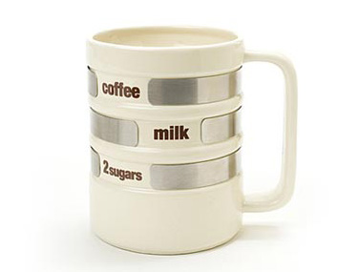
Presentation
Selectors
Selectors are used to select elements on your page and interact with them.
Two types of selector can be used:
CSS Selectors
Specific jQuery Selectors

Slide 16

CSS selectors
Selectors
Take a look at these selectors:
Selector | Returns
* | All elements
element | All element elements
#id | Element with « id » as id
.class | Elements with « class » as class value
elem[attr] | Elements with « attr » attribute specified

Slide 17
CSS selectors
Selectors
Take a look at these selectors:
Selector | Returns
elem[attr="val"] | Elements with « attr » attribute specified with the value « val »
elem1 elem2 | All « elem2 » elements contained in all « elem1 » elements
elem1 > elem2 | All « elem2 » elements directly inside all « elem1 » elements
elem1 + elem2 | All « elem2 » elements immediatly preceded by « elem1 » elements
elem1 ~ elem2 | All « elem2 » elements preceded by « elem1 » elements

Slide 18
Example
Selectors
$('p');
<p> Hey, Dude ! </p>
$('div');
<div> ... </div>
$('#header');
<div id="header"> ... </div>
$('#menu');
<span id="menu"> ... </span>
$('.notice');
<span class="notice"> ... </span>
$('.error');
<span class="error"> ... </span>

Slide 19
Specific jQuery selectors
Selectors
Take a look at these selectors:
Selector | Returns
:hidden | Hidden/invisible elements
:visible | Visible elements
:not("selector2") | Elements not selected by the selector « selector2 »
:has("selector2") | Elements containing elements selected by the selector « selector2 »
:contains("text") | Elements containing the text « text »

Slide 20
Specific jQuery selectors
Selectors
Take a look at these selectors:
Selector | Returns
:eq(number) | Returns the element at index « number » (zero-based)
:first | The first element. Same as :eq(0)
:last | The last element
:even | Elements with even index
:odd | Elements with odd index

Slide 21
Example
Selectors
$('img:hidden')
<img src="1.png" style="display: none;" />
$('img[src$=.png]')
<img src="1.png" style="display: none;" />
$("p:contains('Hi'):has(span)")
<p> Hi ! <span class="smth"> Buddy </span></p>

Slide 22
Questions ?

Slide 23
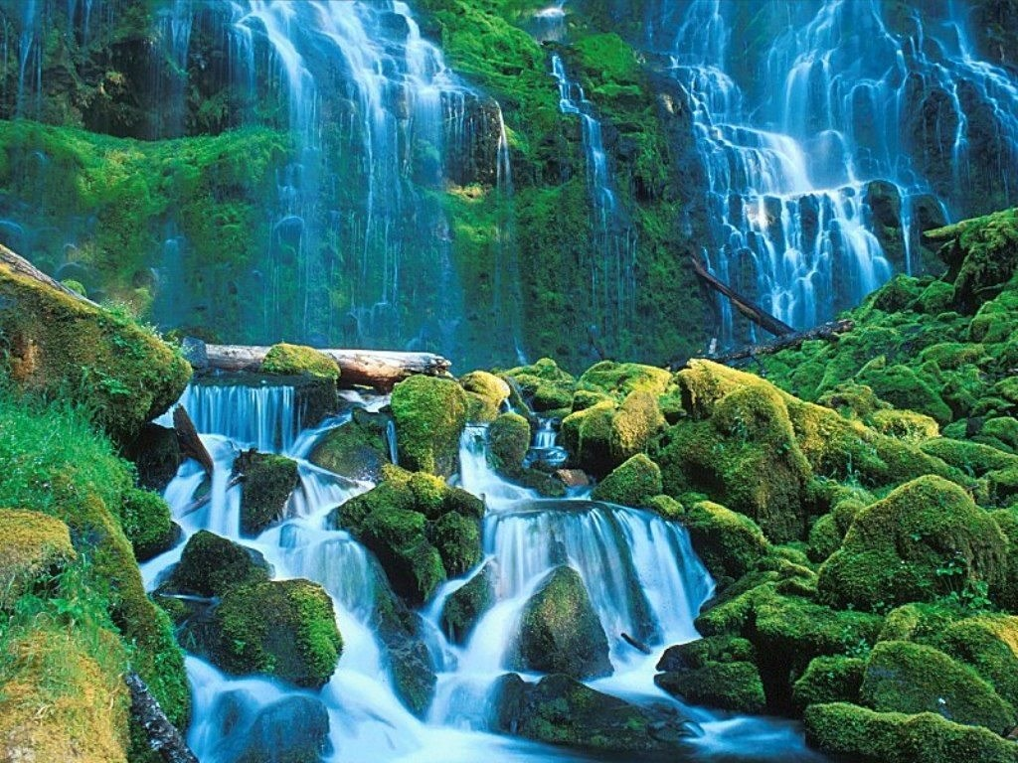
Css manipulation
jQuery

Slide 24
CSS Functions
CSS Manipulation
Easy CSS manipulation thanks to functions below:
.css( propertyName )
Get the CSS property value
.css ( properyName, value )
Set the CSS property
var color = $("div").css("background-color");
console.log(color); // outputs rgba(0, 0, 0, 0)
$("div").css("background-color", "cyan");
var color = $("div").css("background-color");
console.log(color); // outputs rgb(0, 255, 255)

Slide 25
CSS Functions
CSS Manipulation
Easy CSS manipulation thanks to functions below:
.css ( map )
Set all the CSS properties contained in the map
$("p").css({
"background-color" : "cyan",
"font-weight" : "bolder",
"cursor" : "pointer"
});

Slide 26
Show/Hide
CSS Manipulation
Show an element:
Hide it:
Toggle (hide if visible, show if hidden)
$("#myElement").show();
$("#myElement").hide();
$("#myElement").toggle();
Notes:
Note: You can specify a duration in milliseconds in brackets, or one of these keywords: « slow », « normal » or « fast »

Slide 27
Fading
CSS Manipulation
Show an element gradually:
Hide an element gradually:
Toggle gradually (hide if visible, show if hidden)
$("#myElement").fadeIn();
$("#myElement").fadeOut();
$("#myElement").fadeToggle();
Notes:
Note: You can specify a duration in milliseconds in brackets, or one of these keywords: « slow », « normal » or « fast »

Slide 28
Sliding
CSS Manipulation
Show an element by sliding:
Hide an element by sliding:
Toggle by sliding (hide if visible, show if hidden)
$("#myElement").slideDown();
$("#myElement").slideUp();
$("#myElement").slideToggle();
Notes:
Note: You can specify a duration in milliseconds in brackets, or one of these keywords: « slow », « normal » or « fast »

Slide 29
Animations
CSS Manipulation
If the previous animations didn’t fit your needs:
.animate( properties, [ duration ])
All animated properties should be a single numeric value
Properties like width, height, or left can be animated but background-color can’t
In addition to numeric values, each property can take « show », « hide » and « toggle » as values
Animated properties can also be relative thanks to leading += and -= operators
Duration value is in milliseconds or one of the following: « slow », « normal », « fast »

Slide 30
Animations
CSS Manipulation
If the previous animations didn’t fit your needs:
.animate( properties, [ duration ])
Find a complete example of all these animations at the following URL: http://jsfiddle.net/bE4sr/1/
$("#test").animate({
left: '+=50',
opacity: 'show'
}, 500);

Slide 31

Questions ?

Slide 32

Exercise
CSS Manipulation
We’re going to play with jQuery and add some CSS properties to our Resume page
First, install jQuery in your page
Then, use jQuery to add a background color to your link to Google
Third, your « More about me » title has to blink
Finally, use the animate function to add a grow effect to your main title!

Slide 33

Events
jQuery

Slide 34
Presentation
Events
Methods to keep clean separation of structure (HTML) and behaviours (JavaScript)
No more need to use HTML event attributes
onclick
onblur
onload

Slide 35
Presentation
Events
Using:
$( selector ).event( function() { code });
Example:
$("a").click( function(){
alert("Hello World");
});
Anonymous function

Slide 36
Presentation
Events
Here are some jQuery events. Just replace « handler » by the function you want to use:
Function | Description
.blur( handler ) | When the element loses focus
.change( handler) | When the element’s value changes (checkbox, select, …)
.click( handler ) | When the element is clicked
.focus( handler ) | When the element gains focus
.submit( handler ) | When the user attemps to submit a form

Slide 37
Presentation
Events
Here are some jQuery events. Just replace « handler » by the function you want to use:
Function | Description
.keydown( handler ) | When a key is pressed on the keyboard
.keyup( handler) | When a key is released on the keyboard
.mouseover( handler ) | When the cursor is over the element
.mouseout( handler ) | When the cursor leaves the element
… | …

Slide 38
Quizz
Events
What does this snippet do?
$("form").submit( function() {
if ($("input:first").val() == ”admin") {
$("span").text("Welcome Mr Admin").show(); return true;
}
$("input:first").css("background-color", "red");
$("span").text("Not valid!").show().fadeOut(1000);
return false;
});

Slide 39
What is « this » ?
Events
jQuery provides the this keyword
Refers to the selected element inside nested functions
<div class="test">Rock Paper Scissors Lezard Spock</div>
<div class="test">One Two Three Four Five</div>
<script type="text/javascript">
$(".test").hover( function() {
$(this).css("color", "pink"); // Refers to the .test element actually being hovered
}, function() {
$(this).css("color", "black"); // Same
});
</script>

Slide 40
Callbacks
Events
Did you notice in the previous example?
The « hover » function took two anonymous functions in parameter
The first one is launched when the event is raised
The second one is called callback function
Executed when the event is finished

Slide 41
Callbacks
Events
Most functions that accept callbacks are animation ones:
fadeIn()
fadeOut()
slideUp()
slideDown()
…
<div id="test">
Rock Paper Scissors Lezard Spock
</div>
<script type="text/javascript">
$("#test").slideUp(1234, function(){
alert("You closed the div.");
});
</script>

Slide 42
Questions ?

Slide 43
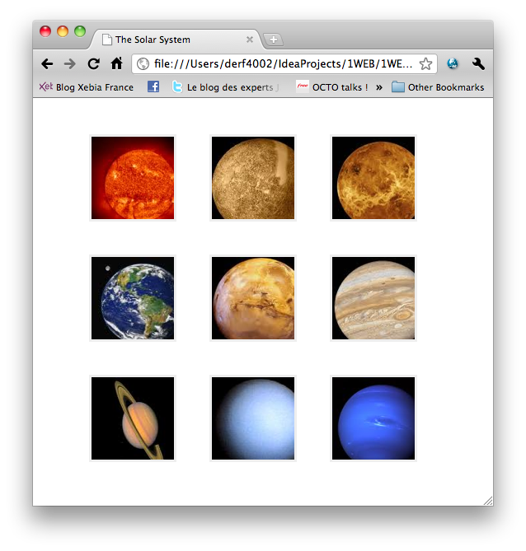
Exercise (1/2)
Events
Create a new webpage named solar_system.html
The HTML must just be an unordered list of images
Use CSS to make the page look like this :
The pictures you need are on courses.supinfo.com

Slide 44
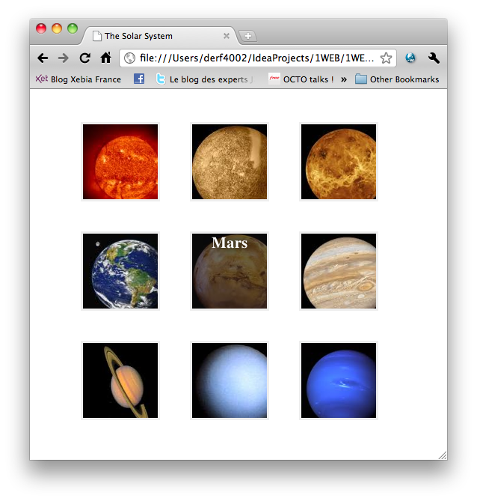
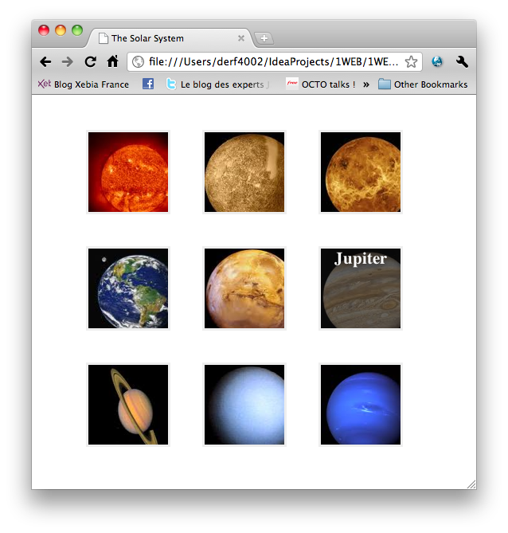
Exercise (2/2)
Events
When your mouse passes over an image:
It has to become darker and display the planet name

Slide 45
Content Manipulation
jQuery

Slide 46
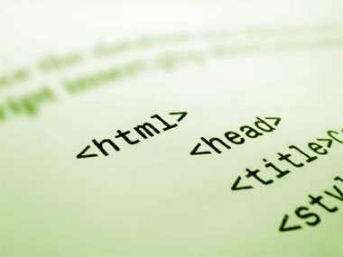
Presentation
Content manipulation
jQuery provides methods to add, retrieve, edit and remove HTML content
We’re going to discover and explain them!

Slide 47
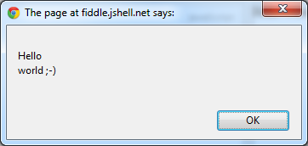
Textual content
Content manipulation
.text()
Get the combined text contents of each element in the set of matched elements, including their descendants
<p id="test">
<span class="text">Hello</span>
<span class="text">world ;-)</span>
</p>
<script type="text/javascript">
var text = $("#test").text();
alert(text);
</script>

Slide 48
Textual content
Content manipulation
.text( textString )
Set the content of each element in the set of matched elements to the specified text
<p id="test"> <span class="text">Hello you ;-)</span> </p>
<script type="text/javascript">
$("#test").text("<span>Hello by jQuery!</span>");
</script>
<p id="test">&lt;span&gt;Hello by jQuery!&lt;/span&gt;</p>

Slide 49
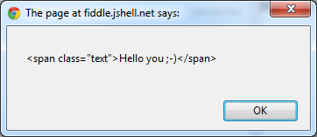
HTML Content
Content manipulation
.html()
Get the HTML contents of the first element in the set of matched elements
<p id="test">
<span class="text">Hello you ;-)</span>
</p>
<script type="text/javascript">
var text = $("#test").html();
alert(text);
</script>

Slide 50
HTML Content
Content manipulation
.html( textString )
Set the HTML contents of each element in the set of matched elements
<p id="test"> <span class="text">Hello you ;-)</span> </p>
<script type="text/javascript">
$("#test").html("<span>Hello by jQuery!</span>");
</script>
<p id="test"><span>Hello by jQuery!</span></p>

Slide 51
HTML Content
Content manipulation
.replaceWith( textString )
Replace each element in the set of matched elements with the provided new content
<p id="test"> <span class="text">Hello you ;-)</span> </p>
<script type="text/javascript">
$("#test").replaceWith("<p>Hello by jQuery!</p>");
</script>
<p> Hello by jQuery! </p>

Slide 52

Insert inside an element
Content manipulation
.prepend( textString )
Insert some content at the beginning of each element in the set of matched elements
.append( textString )
Insert some content at the end of each element in the set of matched elements

Slide 53
Insert inside an element
Content manipulation
Example:
<p id="test">
<span class="text">Hello you ;-)</span>
</p>
<script type="text/javascript">
$("#test").prepend("<em>Before</em>");
$("#test").append("<em>After</em>");
</script>
<p><em>Before</em>Hello by jQuery!<em>After</em></p>

Slide 54
Insert outside an element
Content manipulation
.insertBefore( selector )
Insert every element in the set of matched elements before the target
.insertAfter( selector )
Insert every element in the set of matched elements after the target

Slide 55
Insert outside an element
Content manipulation
Example:
<p id="test">
<span class="text">Hello you ;-)</span>
</p>
<script type="text/javascript">
$("<em>Before</em>").insertBefore("#test");
$("<em>After</em>").insertAfter("#test");
</script>
<em>Before</em><p>Hello by jQuery!</p><em>After</em>

Slide 56
Wrappers
Content manipulation
.wrap( wrappingElement )
Wrap an HTML structure around each element in the set of matched elements

Slide 57
Wrappers
Content manipulation
<p class="test">
It’s gonna be legen...
</p>
<p> wait for it </p>
<p class="test"> ...dary ! </p>
<script type="text/javascript">
$(".test").wrap("<div id='barney' />");
</script>
<div id="barney">
<p class="test"> It’s gonna be legen...</p>
</div>
<p> wait for it </p>
<div id="barney">
<p class="test"> ...dary ! </p>
</div>

Slide 58
Copy
Content manipulation
.clone()
Create a deep copy of the set of matched elements
<p class="test">Kage bunshin no jutsu!</p>
<script type="text/javascript”>
$(".test").clone().appendTo("body");
$(".test").clone().appendTo("body");
</script>
<p class="test">Kage bunshin no jutsu!</p>
<p class="test">Kage bunshin no jutsu!</p>
<p class="test">Kage bunshin no jutsu!</p>
<p class="test">Kage bunshin no jutsu!</p>

Slide 59
Remove
Content manipulation
.remove()
Remove the set of matched elements from the DOM
<p class="test"> It’s gonna be legen...</p>
<p> wait for it </p>
<p class="test"> ...dary ! </p>
<script type="text/javascript">
$("p:not(.test)").remove();
</script>
<p class="test"> It’s gonna be legen...</p>
<p class="test"> ...dary ! </p>

Slide 60
Questions ?

Slide 61
Exercise (1/2)
Content manipulation
Modify your solar_system.html page
When you click on an image, it has to be displayed bigger in the center of the screen and all in background have to become darker
Display the bigger image with a toggle effect
To close and return it as the same screen as at beginning, click in the dark area

Slide 62
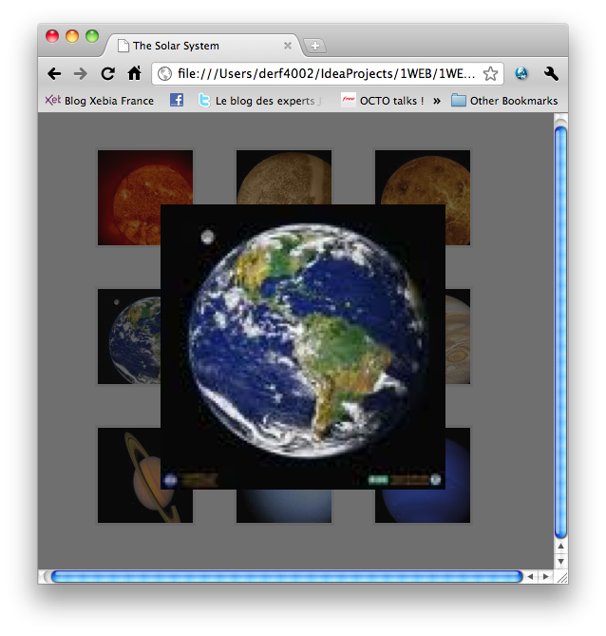
Exercise (2/2)
Content manipulation
Your page should look like this:

Slide 63


The end
jQuery
Thanks for your attention

Slide 64


